Slide 1
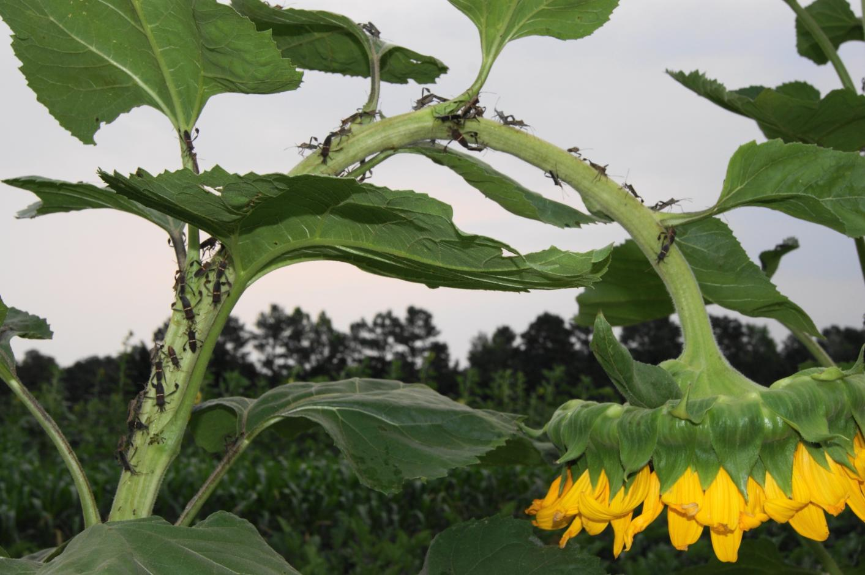
Farmscaping- A Whole Farm Approach to IPM In-Service Training (May 21-22, 2014) Report R. Hochmuth, UF; A. Bolques, FAMU, D. Collins, Alcorn State
Funding support from Southern Region IPM Center

Slide 2
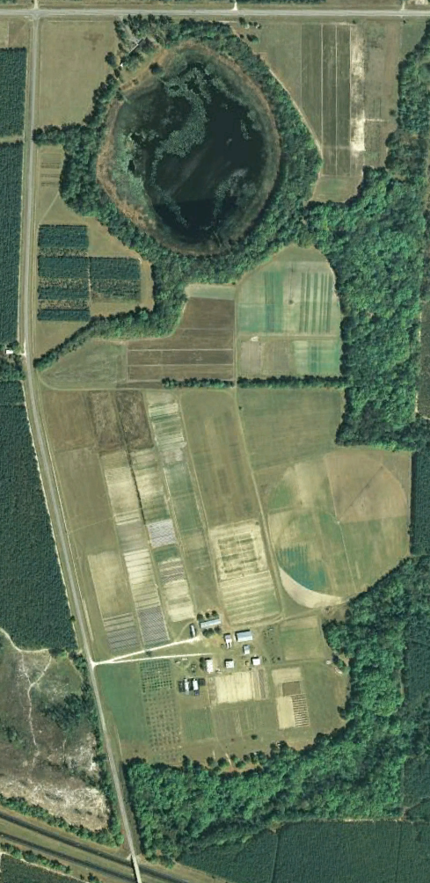
1
IPM Farmscaping Features
1
Bat Houses
2
Bird Boxes
3
Planted Fence Line vs. Natural Fence Line
4
Vegetable IPM Area
3
5
Agronomic Crops ( Sod-based Rotation)
6
Invasive Plant Management Area
4
7
Transitional Organic Plot
5
8
Crape Myrtle Banker Plants
9
Protected Agriculture
8
6
10
Fruit & Nut Orchard
7
8
9
11
Predator Boxes (Solitary Wasps & Bees)
10
12
Brush Piles
13
13
Native Plant Habitat for Beneficials

Slide 3
Project Objectives
Create a field laboratory by transforming an existing farm into a model for developing and teaching IPM principles and techniques beyond the classroom.
Teach farmers, university students and others whole farm IPM approaches for preventing or minimizing pests and associated costs.
Build a sustainable IPM education and training infrastructure for delivering whole farm pest prevention and management practices.

Slide 4
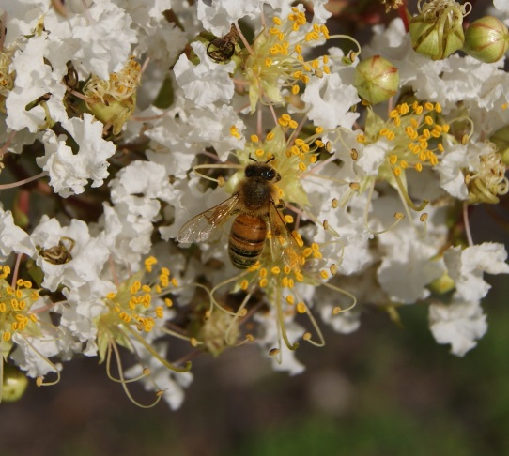
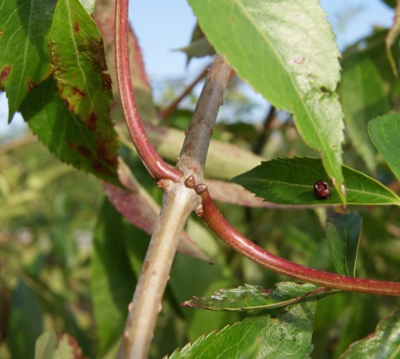
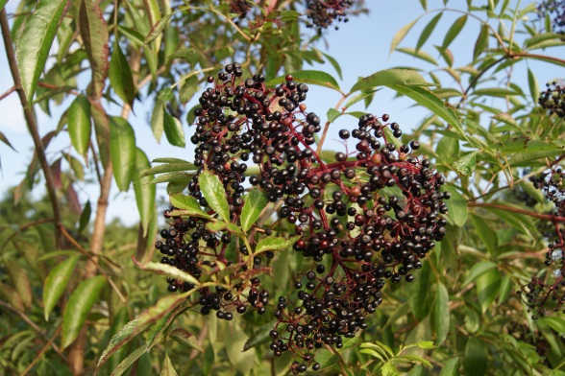
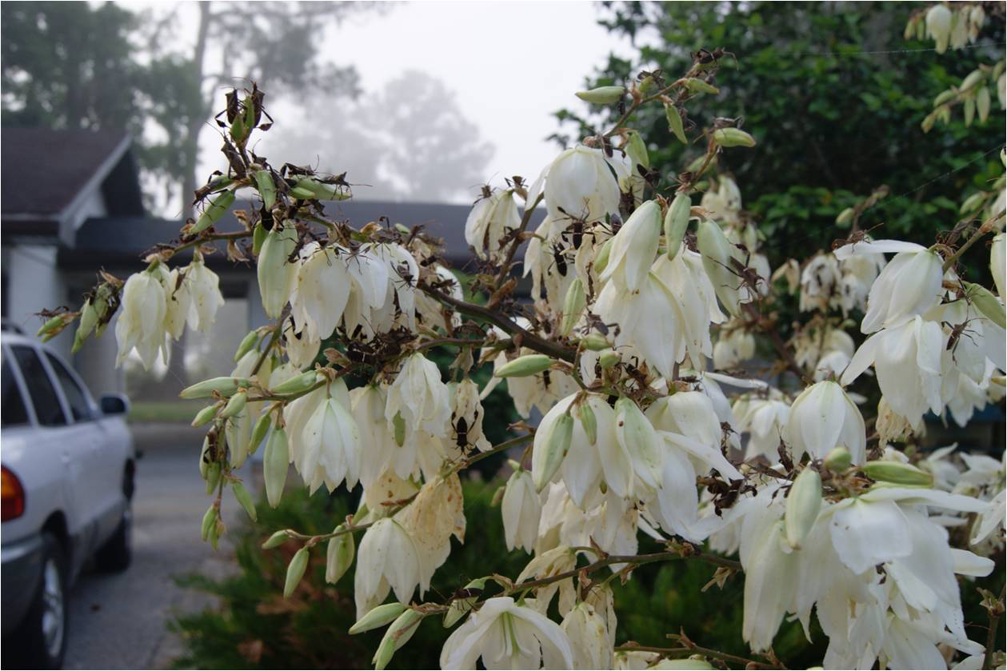
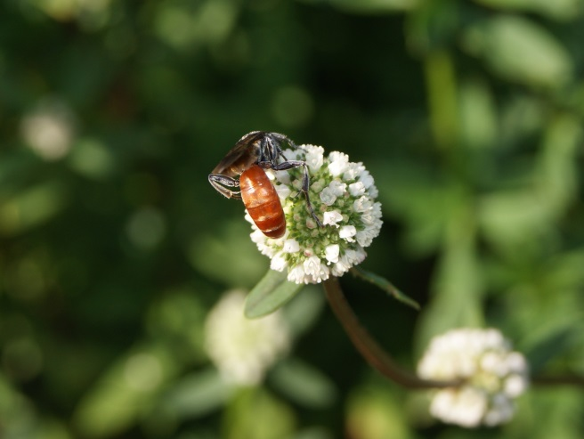
Plants with a Purpose
Extrafloral nectaries
Berries
Elderberry
The flowers attract pollinators.
The berries feed wildlife.
The extrafloral nectaries that provide nectar even when there are no flowers.
Crape Myrtle
Not only a good attractant for pollinators, it is also considered a banker plant because the aphid that is attracted to the crape myrtle is only attracted to the crape myrtle. The aphid attracts predators such as lady beetles or parasitic wasp. As the beneficial populations increase and the aphids decrease , the beneficials move onto other crops searching.
Shrubby False Buttonweed
Spermacoce verticillata
The shallow flowers on the plant attracts many pollinators looking for this feature. The main reason this plant was planted, was due to it’s attractiveness to the Larra Wasp, which uses the mole cricket as a host to reproduce.
Yucca Plant
Used as a trap plant for leaf footed stink bug

Slide 5
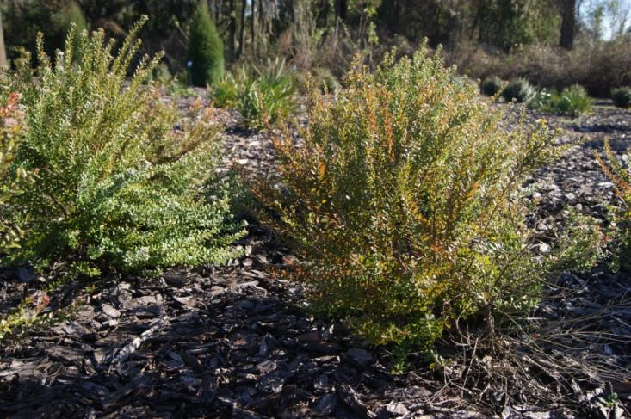
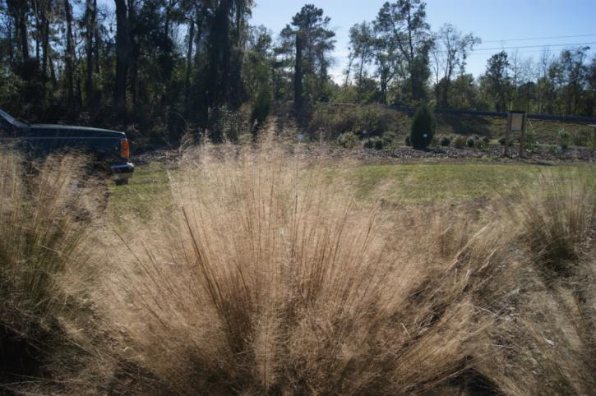
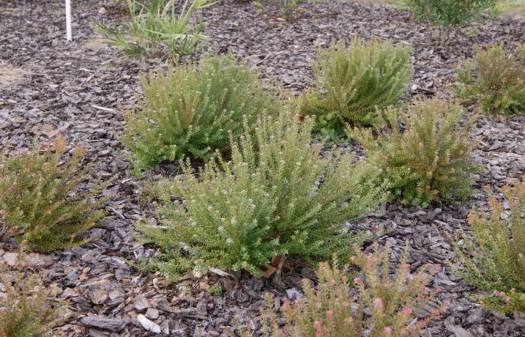
Provide Habitat Year Round

Slide 6
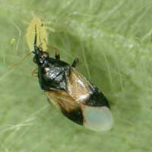
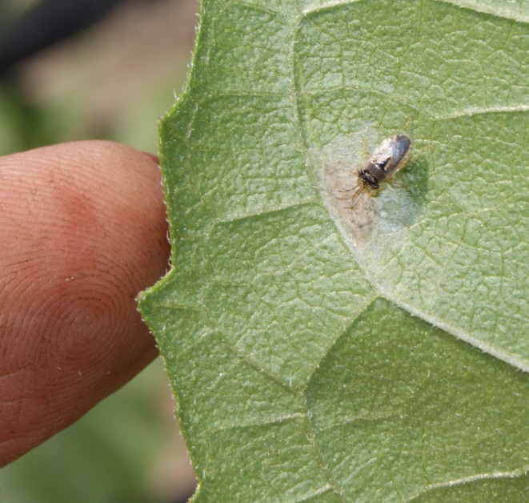
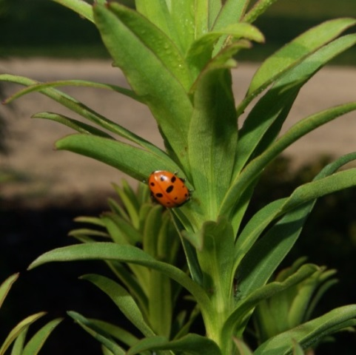
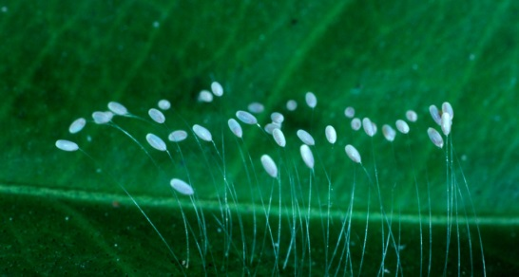
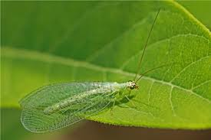
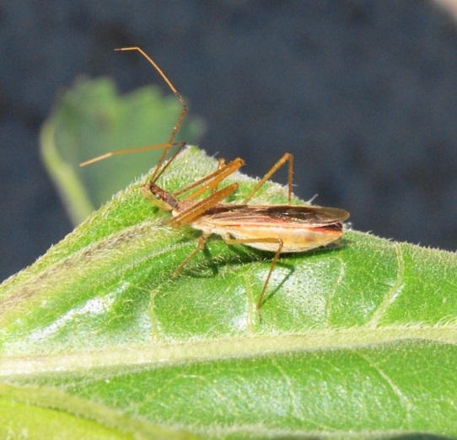
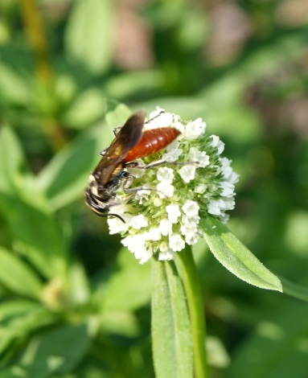
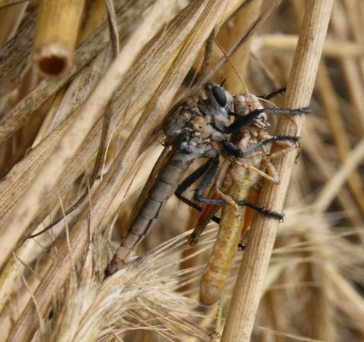
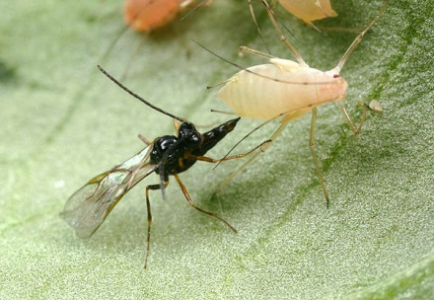
Increasing Beneficials insects
Just some of the beneficials that have increased due to IPM practices adopted
Minute Pirate bug
Orius spp
Big Eyed Bug Geocoris
Lady Bird Beetle (Lady Bug)
Lacewing
Asilidae (Robber Fly)
Parasitic Wasp
Assassin bug
Larra Bi-color wasp

Slide 7
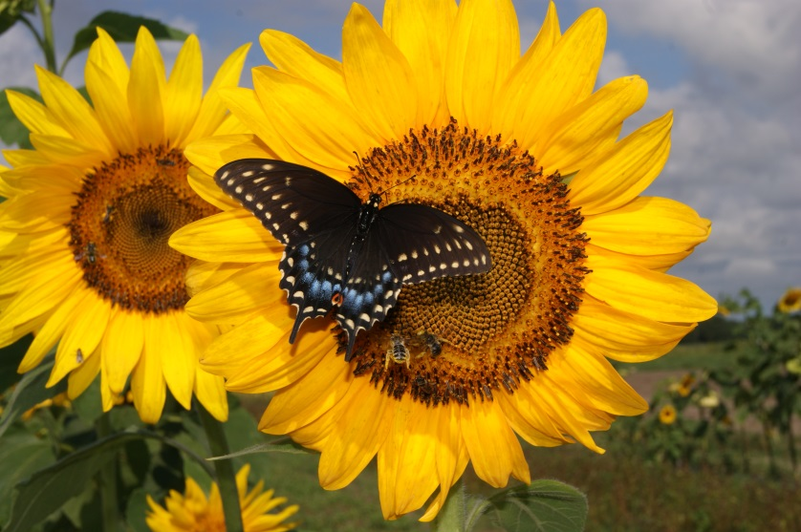
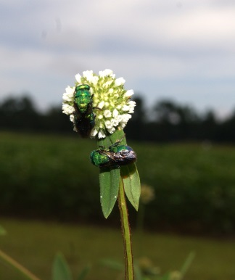
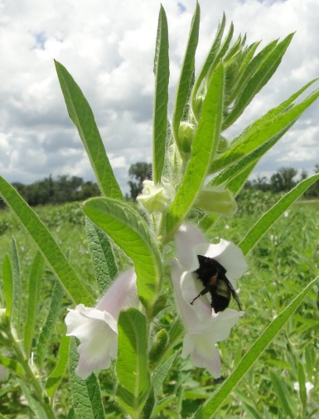
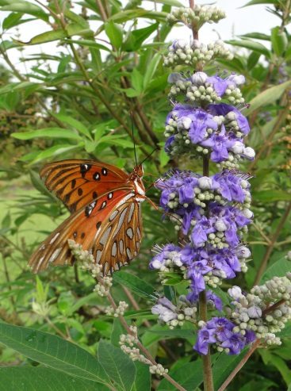
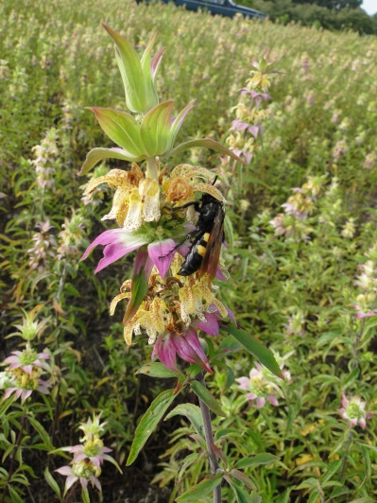
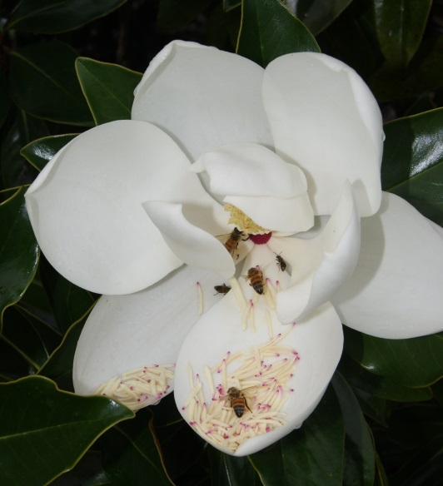
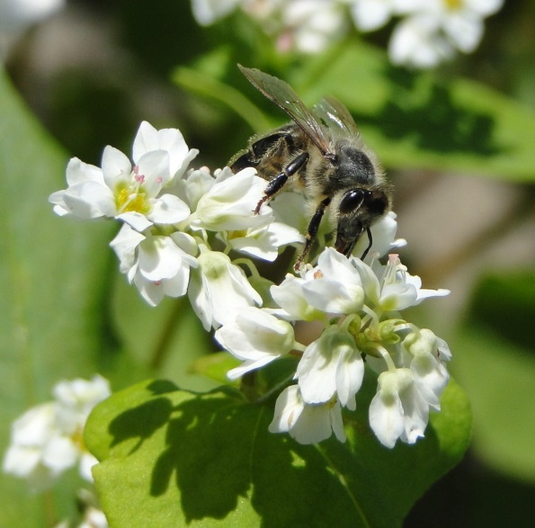
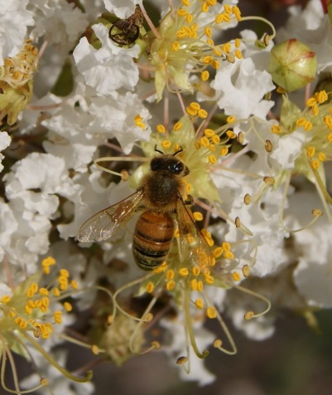
Promoting Pollinators
Although many crops attract various pollinators some crops attract specific ones.
Sunflowers
70% of Florida’s native pollinators are ground dwellers
Shrubby False Buttonweed
Spermacoce verticillata
Chastetree
Vitex agnus-castus
Sesame
Spotted Horsemint Monarda punctata
Crape Myrtle
Buckwheat
Magnolia

Slide 8
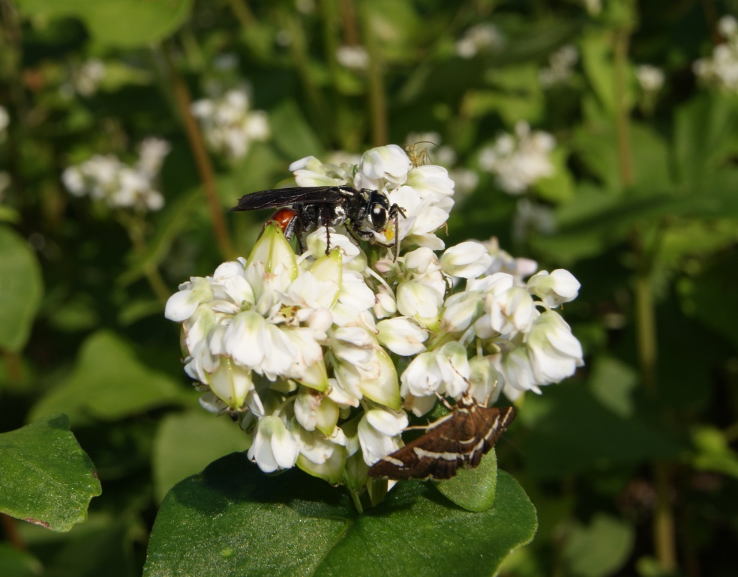
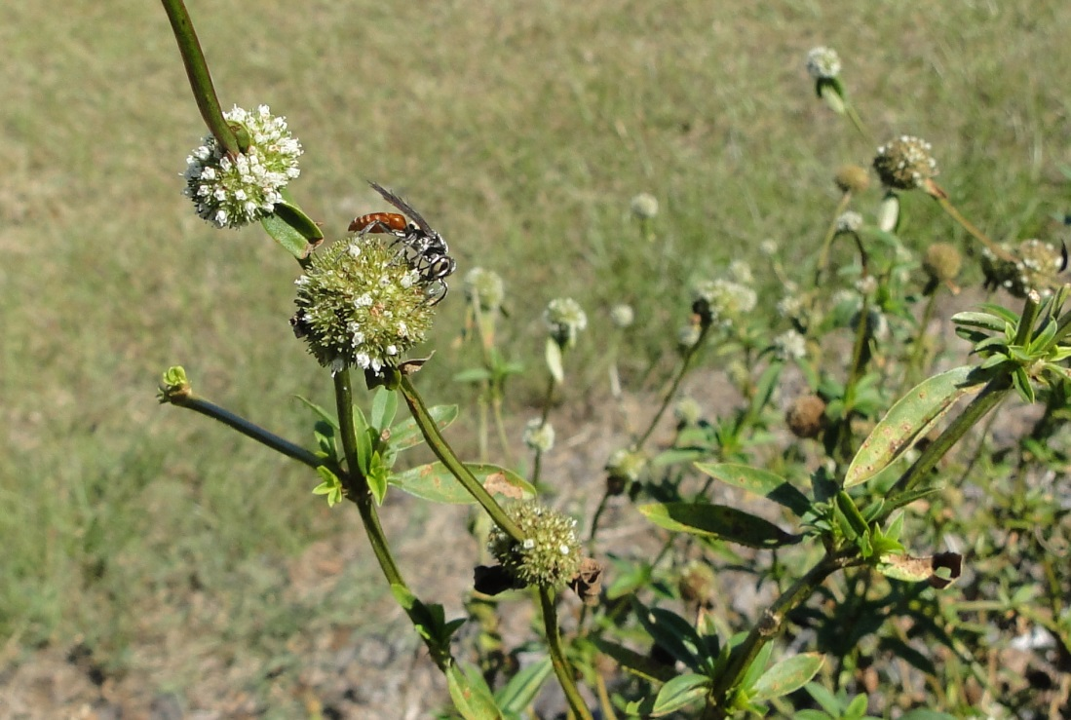
Increasing Larra wasp populations
On buckwheat
Larra Wasp on
Shrubby False Button Weed Spermacoce
in October 2013

Slide 9
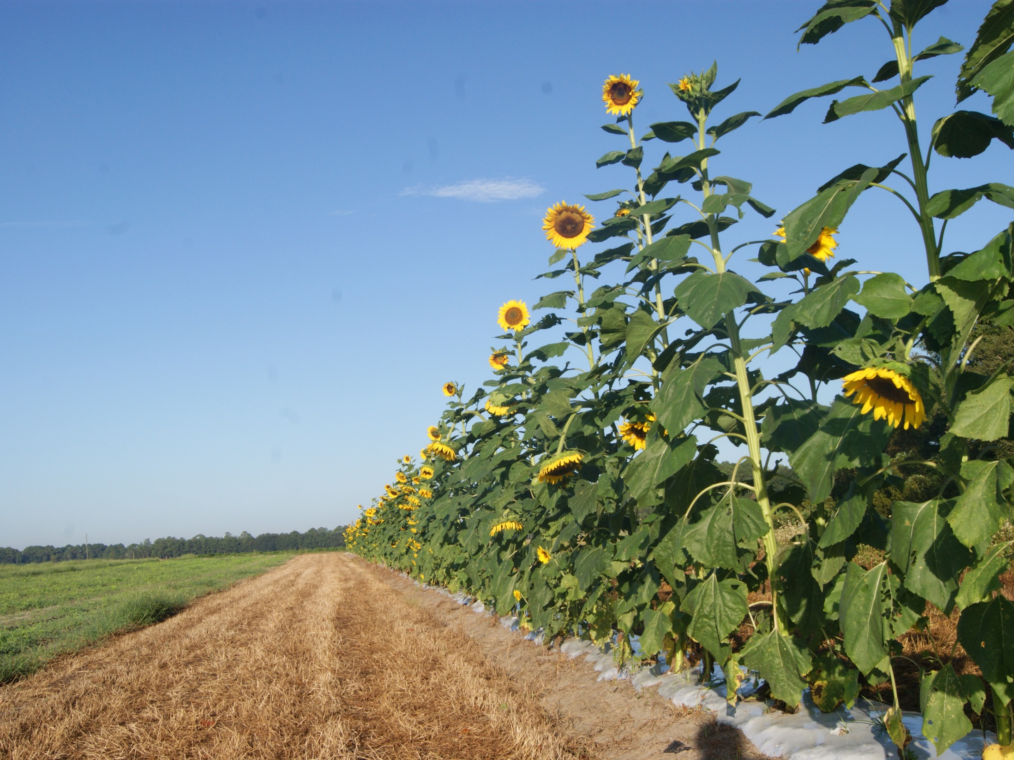
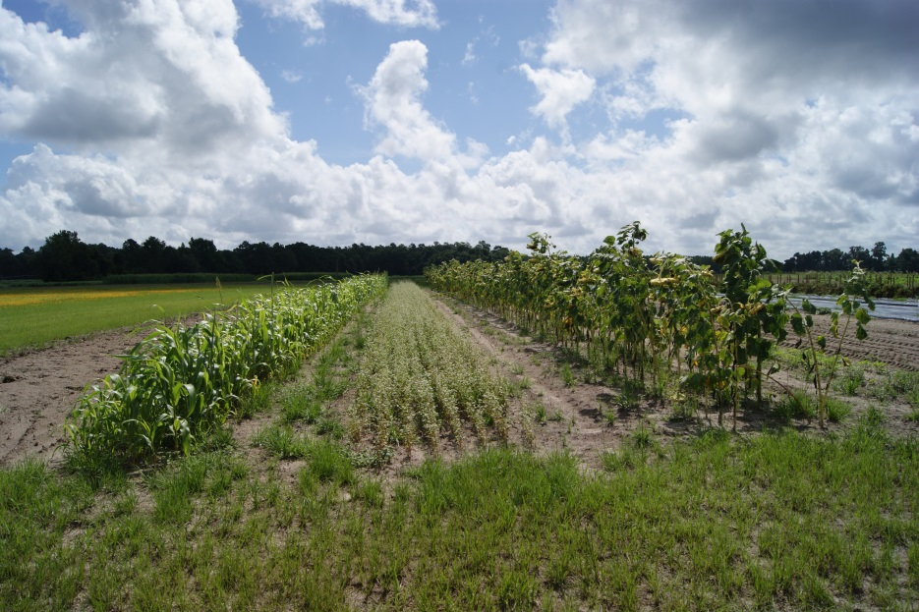
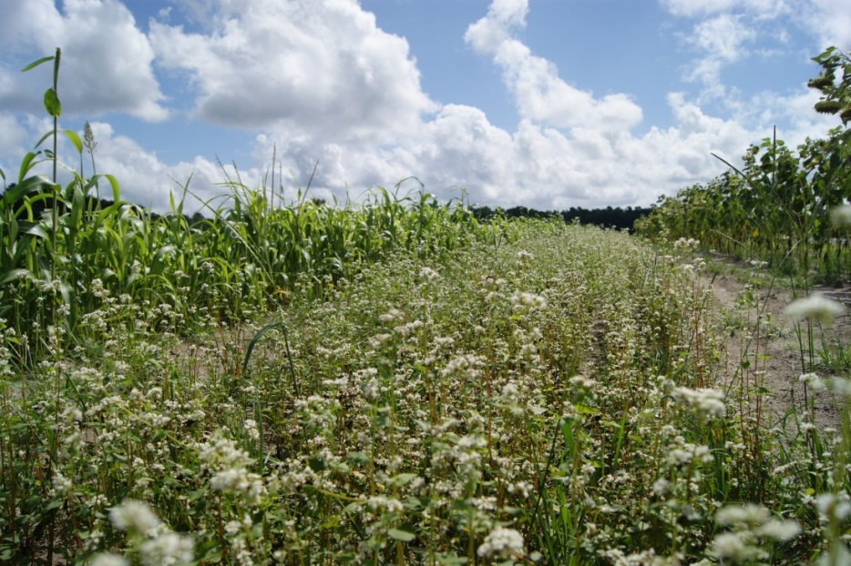
IPM Enhancement Plots
Buckwheat and Sunflowers
Two “must have” crops
NOTE: Ground too hard in some places to no-till. Those areas were tilled and planted, then no-tilled at later plantings as ground allowed.
Crop failure during dry season without irrigation. Ways were used to irrigate during dry seasons.
It was determined to grow sunflowers in a row under plastic to help manage weeds and water. When the sunflowers were spent new sunflowers were inter planted (or sown) between first planting.

Slide 10
Bird Boxes and Bat Houses
All bird houses are at least 30 feet for crops
Bat Houses
Bluebird Boxes
Kestrel Boxes
Chickadee Boxes
Barn owl

Slide 11
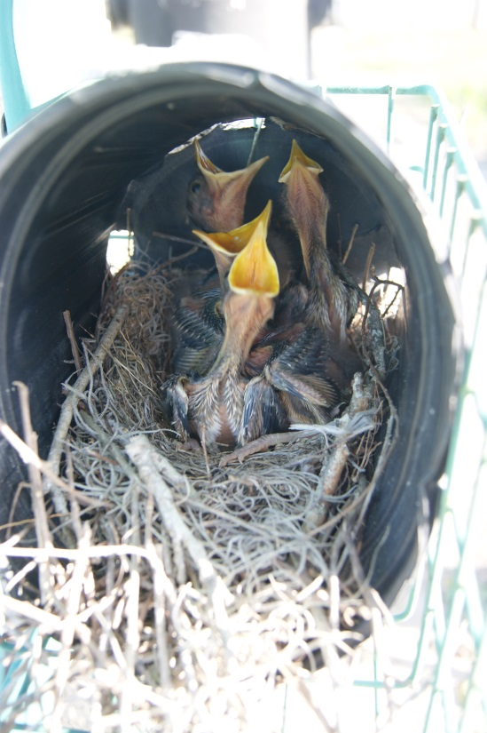
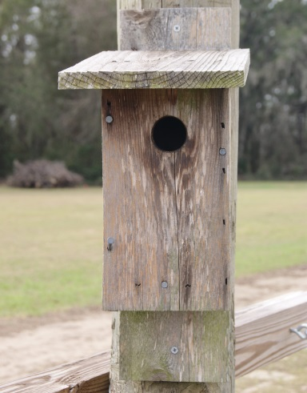
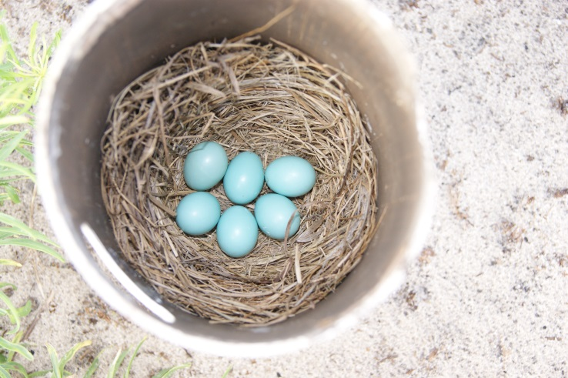
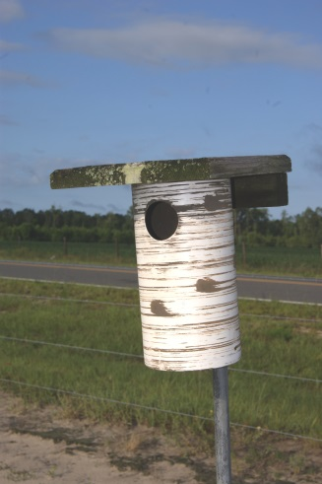
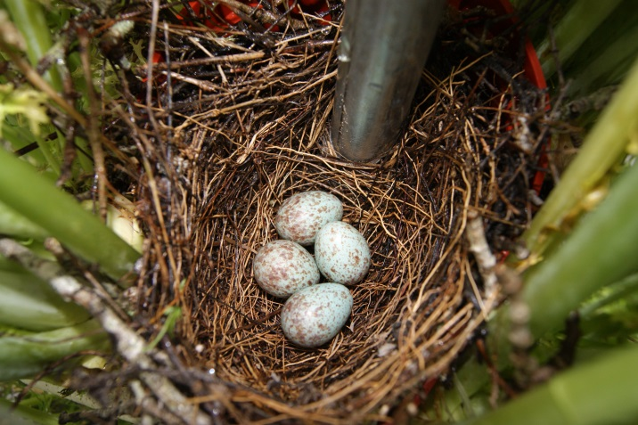
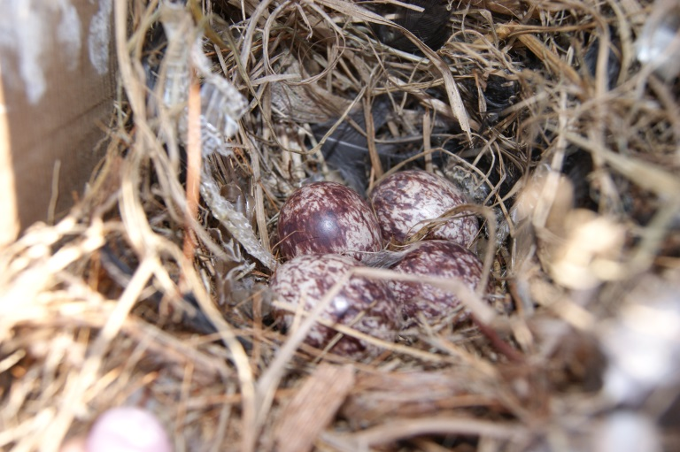
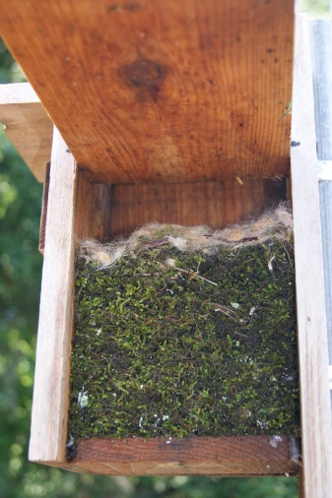
Bluebird
Blue Birds have been easy to establish in various houses
Then there are the Mocking birds who were found nesting where ever they could find a spot.
Above in a plant pot at a hose reel.
Below in the top of a hydroponic system
Some houses are used by various birds such as the one to the left, which was used in the same season at different times
by blue birds and chickadee
Learn to identify eggs and nests
Chickadee nest
Mocking bird
Chickadee

Slide 12
Benefits from IPM Program at SVAEC
Greater than 50% reduction of insecticides
Avoidance of broad spectrum insecticides. Bonus points for pesticide selections
Stink bug trap crop system developed and implemented
Established Larra wasp for mole cricket
Increased numbers and diversity of native pollinators
Bluebird populations occupied 12 houses in 1 year
Increased bat houses populated by two houses
Beneficial habitat established and buckwheat plantings great success
Better timed applications of insecticides for certain worms based on pheromone trapping data
Overall increased biodiversity
Educational opportunities with diverse clientele groups

Slide 13
Evaluation Results of In-Service Training
Organization of the training 4.94
Relevance of topics presented 4.65
Clarity of workshop objectives 4.88
Expertise of instructors 4.76
Quality of educational materials 5.00
Time spend on hands-on activities 4.47
Opportunities for networking with other participants 4.76
Activities to get me involved 4.65
Confident I could teach this topic in my county 4.06
Overall quality of the training 4.88
Pre to Post Test scores increased an average of 19 %

Slide 14
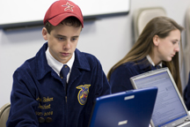
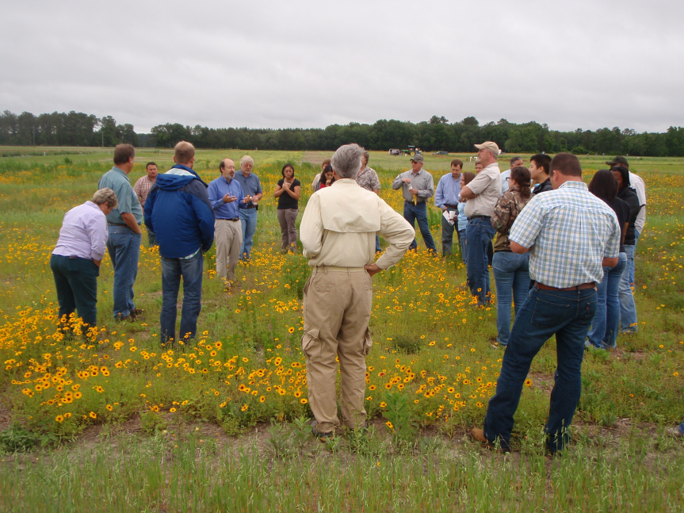
Other Trainings
Small farm specialty crop producers
New and part-time farmers
County Extension agents
State and federal conservation groups
University and other students
Youth groups, e.g., 4-H & FFA
Master Gardeners
Master Naturalists
Rural landowners
Applied Research Faculty
Many others

Slide 15
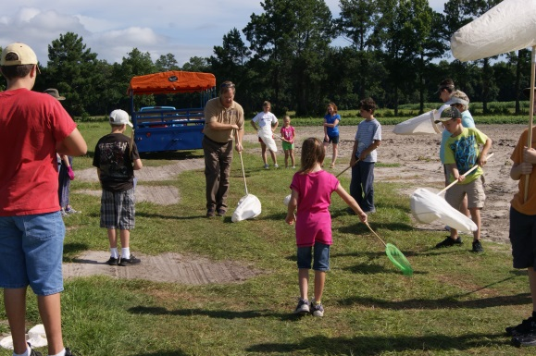
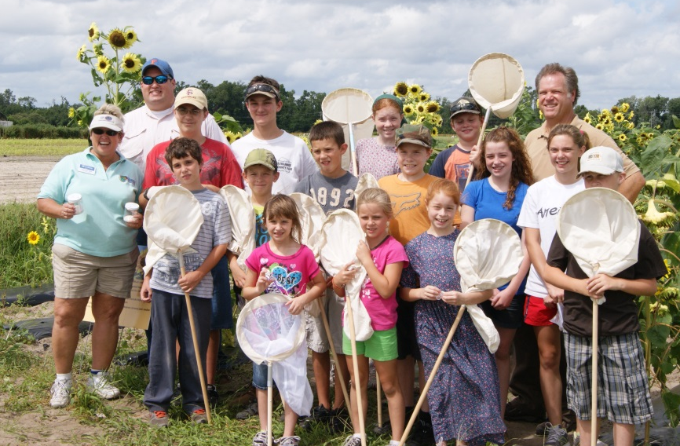
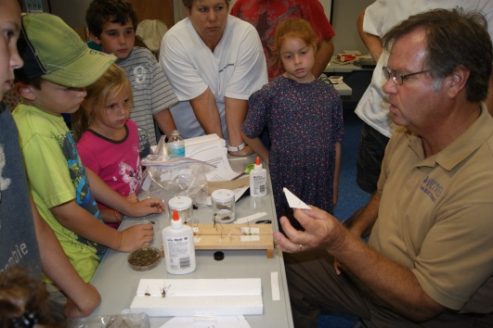
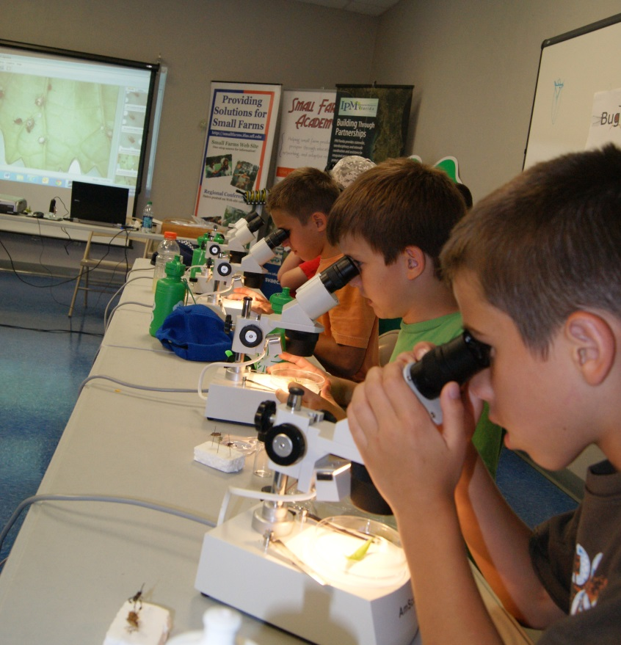
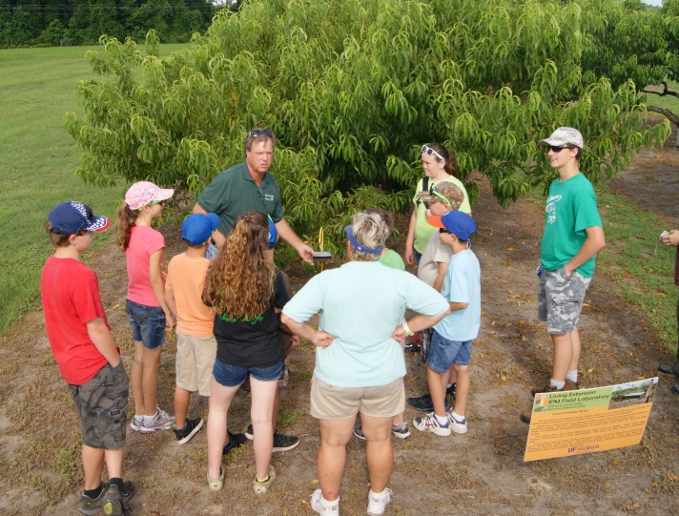
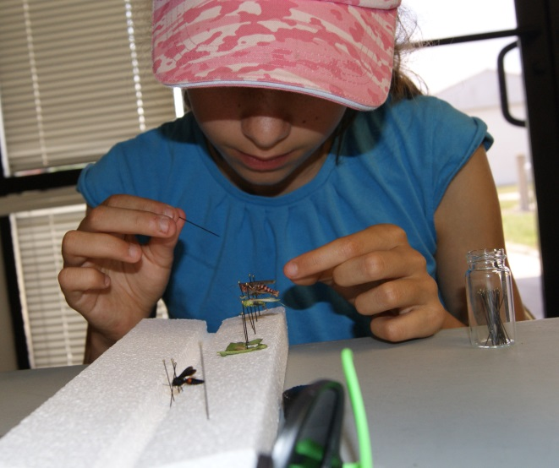
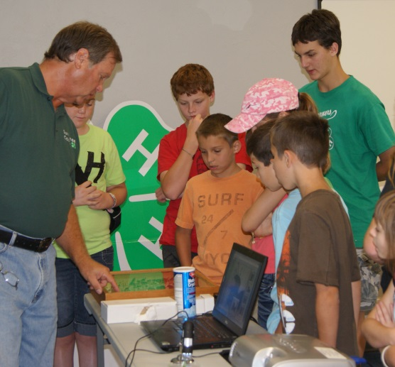
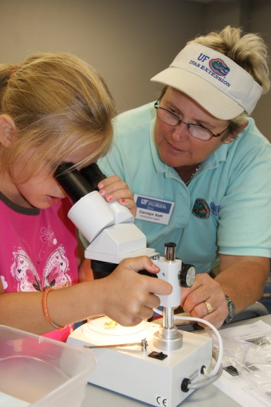
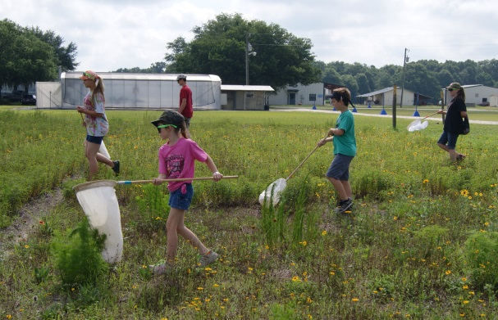
4 H Bug Out Summer Camp

